Slide 1
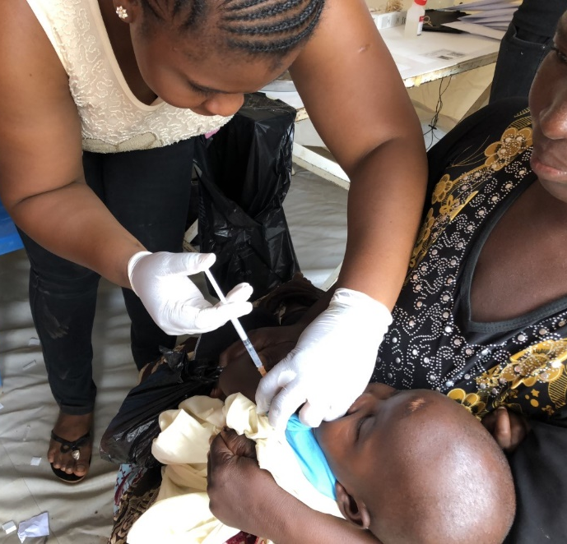
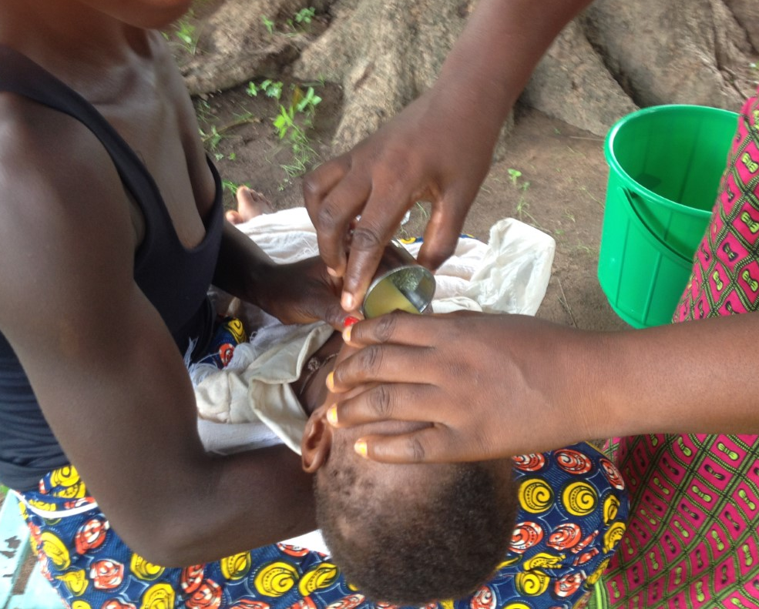
Methodology to assess the Risk of Malaria in Children Who are no Longer Eligible for Seasonal Malaria Chemoprevention (SMC) or Seasonal Vaccination in Burkina Faso and Mali
ASTMHLB-8376-Session 75:
Late-Breakers in Malaria
Issaka Zongo MD, PhD
Institut de Recherche en Sciences de la Santé
Bobo-Dioulasso, Burkina Faso

Slide 2
Background
- Seasonal malaria chemoprevention (SMC) is widely implemented in Burkina
Faso and Mali and achieves high coverage in both countries.
- Combining the RTS,S vaccine and SMC with SPAQ provided added
protection over five years against clinical malaria, severe malaria, and malaria
deaths compared to either intervention when used alone.*
- Children who have stopped receiving SMC and/or RTS,S when they have
reached the age of five years may have an increased susceptibility to
clinical malaria, including severe malaria.
* Dicko et al. LID 2023; Chandramohan et al. NEJM 2021

Slide 3
Hypothesis
Children who have received both SMC plus RTS,S will have more episodes of
uncomplicated malaria and severe malaria compared to children who had received either
SMC alone or RTS,S alone when they become too old (> 5 years of age)
to receive these interventions

Slide 4
A prospective, matched cases-control study to evaluate whether the risk of delayed malaria is enhanced in children who have received RTS,S + SMC for five years than in
children who received just RTS,S or SMC.
1. Uncomplicated Malaria
Definitions and sample size
Uncomplicated malaria cases | Controls
Children from the study cohorts Not eligible for SMC (>5 years of age) Attending a study health facility for clinical malaria (Temp ≥ 37.5°C or H/o fever past 48 hours plus a parasitemia > 5,000 and < 250,000) | Children from the study cohorts Not eligible for SMC (>5 years of age) Residing at least 2 compounds away from the case No recent clinic attendance with malaria
Sample size 450 cases/year/country x 2 years | Sample size 900/ year/country x 2 years (2 per case)

Slide 5
A prospective, matched cases-control study to evaluate whether the risk of delayed
malaria is enhanced in children who have received RTS,S + SMC for five years than in
children who received just RTS,S or SMC.
2. Severe malaria Definitions and sample size
Severe malaria cases | Controls
Admitted to study hospital Not eligible for SMC Primary diagnosis severe malaria (RDT or malaria blood film positive during the hospitalization, or recorded prior to referral) | Hospital controls Admitted to study hospital Not eligible for SMC Diagnosis any other illness than malaria (including external causes) Community controls As for the uncomplicated cases
Sample size 50 cases per year | Sample size 100 hospital controls/year (2 per case) 100 community controls/year (2 per case)

Slide 6
Number of cases enrolled in 2021-2023
Two controls per case
 |  | Uncomplicated malaria |  | Severe Malaria
Cohort # | Year | Mali | Burkina | Mali | Burkina
1 | 2021 | 204 | 331 | 11 | 9
1 | 2022 | 503 | 683 | 8 | 22
2 | 2022 | 499 | 558 | 4 | 25
1 | 2023 | 0* | 24* | 2 | 6
2 | 2023 | 186 | 293 | 1 | 8
Total | 2021-2023 | 1206 | 1572 | 23 | 56
Number of hospital controls
Mali 8 Burkina Faso 6
* Recruitment stopped on March 31 2023

Slide 7
Framework for analysis of factors associated with the risk of delayed malaria
Demography
Age
?Gender
Caretaker’s
SES
Education
Health seeking behaviour
Environment
Rural/urban
Type of house
Breeding sites
vectors
Health system
Distance to HF
Referral system
Quality of care
interventions (type, coverage, dose, duration, age&time)
SMC
Vaccine
LLIN / IRS
Prompt case management
Asymptomatic malaria
Clinical malaria
Severe malaria
- Statistical analysis plan to be written for each case control
study
- Conditional Logistic regression approach will be used for the analyses
- Results are expected in the first trimester of 2024
Immune status

Slide 8






Acknowledgements
LSHTM
IRSS/INSTech
PATH
MRTC
Youssoufa Sidibe
Djibrilla Issiaka
Mahamadou Kaya
Youssou Kone
Oumar Dicko
Hama Yalcouye
Koualy Sanogo
Amadou Tapily
Almahamoudou Mahamar
Ismaila Thera
Issaka Sagara
Alassane Dicko
Ranju Baral
Amber Brown
Karen Ivinson
Cynthia Lee
Clint Pecenka
Heather Richards
Chris Ockenhouse
Issaka Zongo
Charles Zoungrana
Compaoré Yves Daniel
Yerbanga Serge
Abdoul Aziz Sienou
Alassane Haro
Romaric Zerbo
Jean Bosco Ouedraogo
Jane Grant
Paul Snell
Paul Milligan
Daniel Chandramohan
Karen Slater
Brian Greenwood

Slide 9
SPARE SLIDES

Slide 10
RTSS+SMC Trial: Risk of Malaria during post-intervention study Design
Initial three-year study period
Two-year study extension
Transmission season
Transmission season
2017
2018
2019
2020
2021
2022
2023
2024
RTSS/Control vaccinations
Cohort 1
12-17 months at enrolment
SMC/placebo
SMC/Placebo
SMC/Placebo
SMC/Placebo
R
Case-control studies
RTSS/Control vaccinations
Cohort 2
5-11 months at enrolment
SMC/placebo
SMC/Placebo
SMC/Placebo
SMC/Placebo
SMC/Placebo
R
Case-control studies
2017
2018
2019
2020
2021
2022
2023

